Slide 1

GlobalData Analysis: The Impact of Donald Trump's 2024 Win on the Media Sector
Media Intelligence Center
November 2024

Slide 2
Antitrust Inspection and Mergers & Acquisitions (M&A)
Trump expected to take a softer stance on antitrust, paving way for increased M&A activity
The implications of changes in antitrust on the media sector
Warner Bros. Discovery CEO David Zaslav has expressed optimism about potential changes in US media regulation under the future Trump administration. Zaslav indicated that a Trump presidency could facilitate M&A in the media and entertainment sectors by dialling back on some antitrust policies, an opinion shared by many in the media world. Zaslav argues that the current media landscape, with numerous streaming apps and fragmented content, is not consumer-friendly or sustainable. He advocates for consolidation to strengthen media companies and improve the consumer experience by simplifying access to content. Though Trump’s views on antitrust laws do indicate possibility of more industry consolidation, he has put companies and commercial activities under scrutiny in the past, actively attempting to block AT&T’s acquisition of Time Warner, which was ultimately passed by the Department of Justice (DoJ).
M&A in Media
In Q3 2024, the media M&A value globally was of $18 billion, up ~3% year-on-year. Seven deals were recorded that were worth $1 billion or more, including TPG Capital’s acquisition of DIRECTV from AT&T.
The majority ($11.8 billion) came from the North American region, one of the few to report year-on-year growth (+78%).
Scenarios
Looser regulation around M&A activity could lead to media giants merging, with Paramount, Comcast, or Warner Bros. Discovery being the most likely to get involved.
With a desire to have some degree of control over the media, Trump and his alliance with Elon Musk might generate new TV networks or media channels.
Impact Assessment:
Medium
High
If the Trump administration views a company as advantageous for US trade, it is more likely to avoid regulatory attention from the DoJ. However, media conglomerates and social media platforms could face increased pressure if they are perceived as spreading what the Agenda 47, Trump’s campaign and manifesto, vaguely labels as “misinformation.” The most probable scenario is that media consolidation efforts will be evaluated on a case-to-case basis.

Slide 3

News and Content Regulation
Trump has criticized US media and might push for regulatory action against perceived “biased” outlets
Threat to the Federal Communications Commission (FCC)
In November 2024 President-elect Trump sued CBS News for $10 billion, filing a lawsuit seeking damages. This news came after his request to the FCC to revoke CBS’s broadcast license, alleging its 60 Minutes program intentionally distorted an interview with Democratic presidential candidate, Kamala Harris, and called it a “fake news scam.” The FCC is an independent regulatory body for communications in radio, television, wire, satellite, and cable in the US, which Trump recently promised to bring back under presidential authority, thereby threatening its independence. FCC Chairwoman Jessica Rosenworcel responded by reiterating that the FCC does not have the authority to punish broadcasters for political disagreements over content, and that such calls infringe on the First Amendment. (In the US Constitution, the First Amendment prevents the government from making laws prohibiting free exercise of religion, freedom of speech, press and assembly, and means the FCC’s power is very limited in scope when it comes to news content.)
Trump’s War with the Press: A Timeline
Over the years, including his time as president from 2017-2021, Trump has complained about entertainment and news reporting of multiple outlets and networks in the US, including CBS, NBC, and CNN.
February 2017 – Trump tweeted against CBS as being one of the “fake news networks” and an “enemy” to US citizens.
March 2017 – Complained about NBC and ABC over news reporting on a Russia story.
November 2018 – The Trump White House revoked a CNN reporter’s press pass as retaliation for persistent questions at a press conference. Trump called the reporter in question “a terrible person.”
October 2024 – Trump called for the FCC to revoke network CBS’s broadcast license.
November 2024 – Legal action was taken against CBS News network, claiming CBS was guilty of unlawful acts of voter interference through malicious, deceptive news distortion.
Impact Assessment:
Low
Medium
The FCC is controlled by whatever party holds the White House, and any action would be challenged in the courts, which strictly protects the First Amendment rights that can influence content-based laws. Therefore, it would be highly unlikely that even a conservative FCC would have the power to bend the law in favor of Trump, also given he has been unsuccessful in this in the past.
Trump’s win caused discontent from many in the creative industry, and businesses might want to reconsider how they get involved in political conversation to steer away from conflict. A good communication strategy will factor in potential presidential response and be designed to hold up against legal scrutiny.
Global Google Searches: Donald Trump consistently gained more attention than rivals during election campaigns and throughout first presidency
+276,000 digital subscribers in Q4 2016 (In FY2015 The Times added only 186,000)

Slide 4

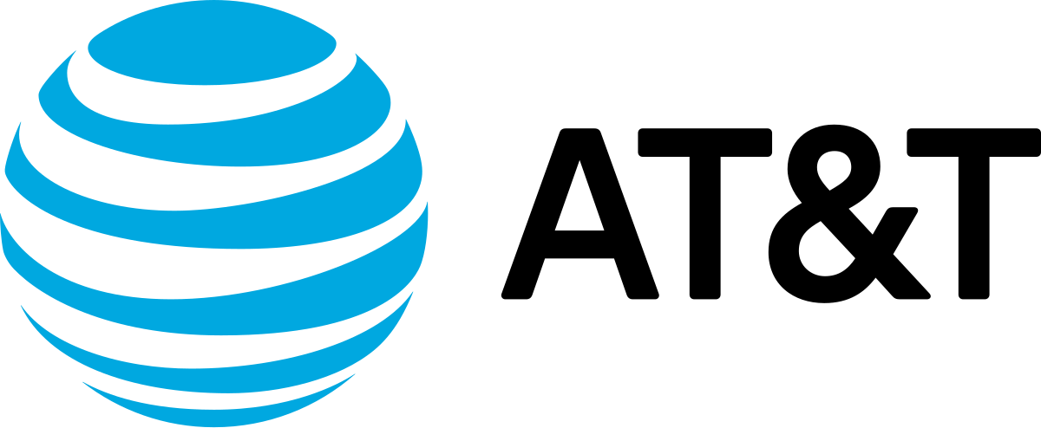

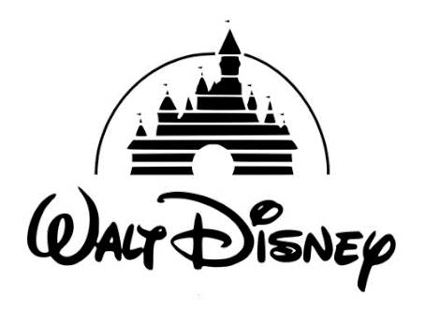
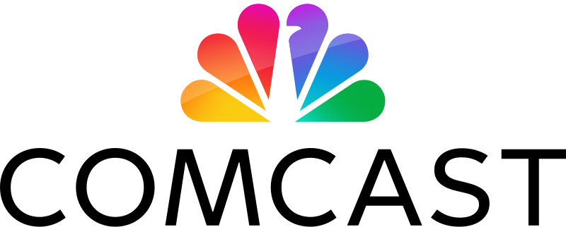
Changes in Costs, Incentives, and International Relations
Trump’s “America First” stance may impact the decisions of producers and distributors of content, with most media giants benefitting
Implications of Trump’s America First strategy
There are several ways in which Trump’s ideology and strategy could influence the entertainment industry. The Motion Picture Association, whose members include the US studios and major streamers, congratulated Trump on his victory, “We look forward to working with him on a wide range of important issues for the film, TV, and streaming industry, which supports more than 2.7 million American jobs, boosts more than 240,000 businesses in cities and small towns across the country, and delivers over $242 billion in wages to our workforce each year.” New tax incentives, dollar movements, tariffs, and general international relations are all factors that will impact film and TV production and export.
Consideration: With the President being a crypto enthusiast, digital assets could offer an alternative source of funding to US films/TV.
Production Costs:
International Relations:
Impact Assessment:
Medium
Scenario 1: Federal tax incentives to incentivize domestic production
Under Trump, federal policy may boost domestic production through favorable tax incentives akin to state-based programs. Trump’s 2017 tax law provisions allowed the deduction of film and TV production costs immediately, rather than spreading it over multiple tax years. Also, the corporate tax rate was lowered from 35% to 21%, and for the film industry specifically, a lower rate on overseas income.
China: Starting a trade war?
Trump's campaign wants to raise tariffs to 60% on China-made products, which could provoke unwanted responses and block US imports to China, impacting the global level of engagement towards US productions. China is currently a big market for US blockbusters. Trump’s campaign pledges taxes of 10-20% on all foreign goods, likely affecting businesses and prices worldwide.
It is probable Trump’s American First strategy will benefit media giants as it did during his first presidency, lowering corporate taxes and rates on overseas income. Creating incentives for domestic production may not be a priority for Trump, but both a strong dollar and nationalistic incentives will influence production costs and decisions as to where to shoot, and with whom to partner and export. Such changes will not disrupt the sector completely but carry critical considerations for businesses.
Comcast and Disney were the media players to benefit the most from Trump’s first presidency. Cost savings from 2018-2021:
Scenario 2: Shooting overseas could become more favorable
A strong dollar against the pound and the euro could strengthen the appeal of the UK and Europe as cost-effective locations to shoot.
Russia: Re-opening the market
Since the war with Ukraine, most US studios pulled out of Russia. The situation could change under the Trump government, potentially re-opening a huge market for US and international films.
$8.2bn
$8bn
$6.1bn
$6.6bn
Notes:
https://itep.org/corporate-taxes-before-and-after-the-trump-tax-law/

